Slide 1
Qualities of Effective Assessment procedure
Faculty of Nursing Cairo University
Evaluation & Testing in Nursing Education 02808
First Semester 2024 / 2025
Level: Doctorate
Supervised by:
Prof. Dr. Effat Alkarmalawy
Prof. Dr. Enas Helmi
Assist. Prof. Dr. Heba Ahmad
Prepared by
Aisha Saad Nassar
Eslam Ibrahim Mohy Eldin

Slide 2
Objectives
1. Describe the characteristics of appropriate assessment tools.
2. Differentiate between different types of validity & reliability.
3. Explains the concept of assessment validity, the role of reliability, and their effects on the interpretive quality of assessment results.
4. Explains the concept of assessment validity, the role of reliability, and their effects on the interpretive quality of assessment results.
5. Describe the threats of validity & reliability and how to overcome them.
6. Implement the validity & reliability in research practice.

Slide 3
Outlines
1. Introduction
2. Definition of validity
3. Types of validity
4. Exam of validity
5. Threats of validity
6. Definition of reliability
7. Types of reliability
8. Factors That Influence the Reliability of Scores
9. Comparison between validity and reliability
10. Practically
11. Application

Slide 4
Introduction
Validity and reliability are two essential concepts used for measuring instruments to evaluate the quality of research.
These two concepts play an integral role in ensuring the accuracy, consistency, and credibility of our research findings.
In addition, assessment tools should be practical and easy to use.

Slide 5
Characteristics of an appropriate assessment tools.
Validity: An appropriate assessment tool measures what it is intended to measure.
Reliability: The tool should deliver consistent results when the same individual is tested under similar conditions.
Fairness: The tool should not favor or disadvantage specific groups or individuals.
Practicality: The tool should be easy to administer, score, and interpret.

Slide 6
Cont…
Relevance: The tool should be relevant and applicable to the specific context in which it is being used.
Sensitivity: The tool should be sensitive to changes over time.
Comprehensiveness: The tool should assess all relevant facets of the construct it's designed to measure.
Authenticity: The tool should represent tasks or situations that are similar to real-world applications or contexts, making it meaningful and applicable.

Slide 7
Validity
Validity is defined as the extent to which an instrument measures what it purports to measure and does so cleanly without accidentally including other factors. (Thanasegaran, 2009).
Definitions of validity have changed over time.
The current philosophy of validity continues to focus on the meaningfulness of the interpretations that teachers make of assessment results.

Slide 8
Types of Validity
There are several types of validity commonly discussed in the field of assessment.
Face Validity.
Construct.
Content.
Assessment–Criterion Relationship Considerations.
Consideration of Consequences.

Slide 9
Face Validity
General appearance.
Refers to the extent to which an assessment appears to measure what it intends to measure on the surface.
It is a subjective judgment based on whether the assessment seems relevant and appropriate to the intended construct.

Slide 10
Construct Validity
Measuring individual characteristics because it explains some observed behavior.
Assesses the extent to which an assessment measures the underlying theoretical construct or concept it intends to measure.
Common methods include:
Convergent validity (positive correlations with other tests of same construct)
Divergent validity (lack of correlation with tests of different constructs).

Slide 11
Content Validity
This examines the extent to which a test measures all aspects of the specific domain or construct it's supposed to assess.
key points about content validity:
Comprehensiveness: The tool should cover all the aspects related to the construct.
Representativeness: The content of the assessment should reflect the entire range of the construct's domain.

Slide 12
Assessment–Criterion Relationship Considerations
More accurate, standardized.
Refers to the degree to which the results of an assessment correlate with a separate, external criterion that's known to measure the same construct.
Can be divided into two types:
Concurrent Validity: The test results are correlated with the results of a criterion measure taken at the same time.
Predictive Validity: The test results are correlated with the results of a criterion measure taken at a future time.

Slide 13
Consideration of Consequences
also known as Consequential Validity.
Is a relatively recent addition to our understanding of validity.
It refers to the intended and unintended consequences that occur as a result of the interpretation and use of assessment results.
These consequences might be positive or negative.

Slide 14
Exam validity
Define
Define the Construct.
Determine
Determine the Types of Validity.
Collect
Collect Validity Evidence.
Analyze
Analyze Face Validity.
Assess
Assess Content Validity.
Evaluate
Evaluate Construct Validity.
Explore
Explore Criterion-Related Validity.
Consider
Consider Consequences.
Synthesize
Synthesize Validity Evidence.
Interpret
Interpret and Report Validity.

Slide 15
Threats of validity
History:
External events occurring during the study influence the results.
Maturation:
Natural changes over time in the sample affect outcomes.
Treatment effects:
refer to the influence of the intervention or treatment being studied on the outcomes.

Slide 16
Threats of validity
Instrumentation :
Differences in test, observer, or scoring methods.
Attrition:
Loss of participants over time.
Bias:
Refers to systematic errors or influences that distort the study results.
Selection effects:
systematic differences between or among the groups compared in a study

Slide 17
Reliability
Reliability refers to the consistency of assessment results. If an assessment produces reliable scores, the same group of students would achieve approximately the same scores if the same assessment were given on another occasion, assuming that no further learning had taken place during the time interval. Each assessment produces a limited measure of performance at a specific time.
Example: Standard Tools.

Slide 18
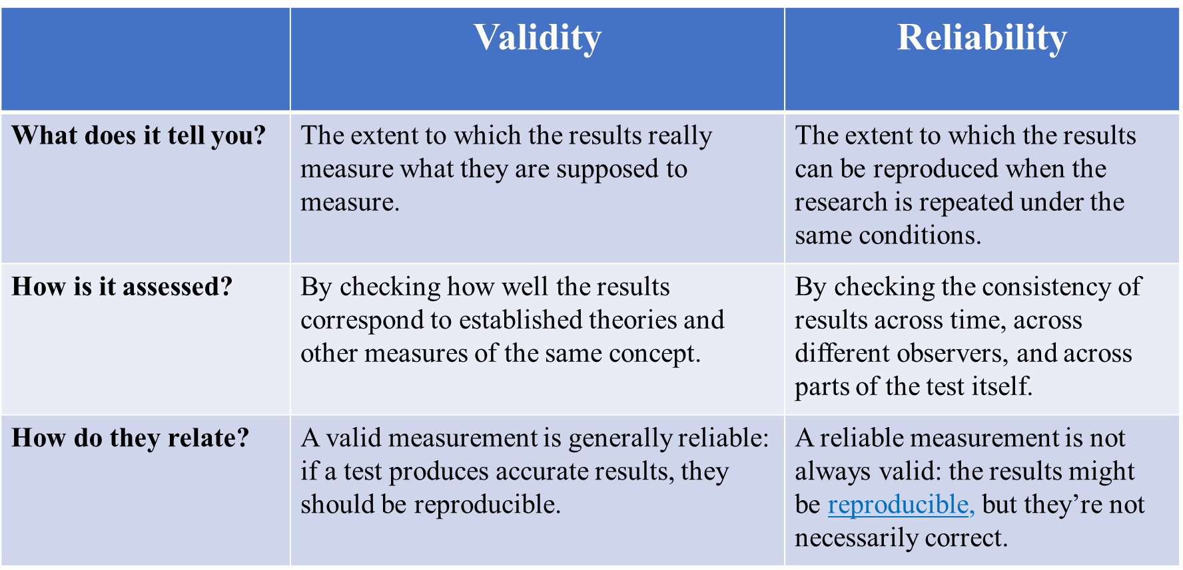
Comparison between validity and reliability

Slide 19
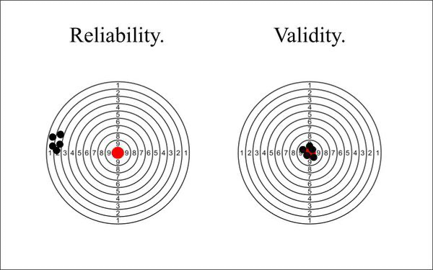
Comparison between validity and reliability

Slide 20
Practicality
Although reliability and validity are used to describe the ways in which scores are interpreted and used, practicality (also referred to as usability) is a quality of the assessment instrument itself and it’s administration procedures.

Slide 21
Types of Reliability
Internal Reliability Consistent of results between test items. | External Reliability Consistent of scores between observer.
1. Internal consistency | 1. Test-retest reliability
 | 2. Intra- Rater Reliability
 | 3. Parallel-Forms Reliability

Slide 22
Testing for External Consistency Reliability
This measures consistency from one occasion to another, the same result should be found on different days, in different labs, observation or interviews, by different researchers.
1. Test-retest reliability
2. Intra- Rater Reliability
3. Parallel-Forms Reliability

Slide 23
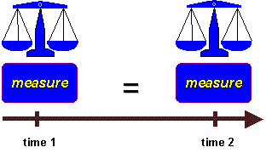
Testing for External Consistency Reliability
1. Test-retest reliability
Measures the consistency of results when you repeat the same test on the same sample at a different point in time (from one time to another).
How to measure it
To measure test-retest reliability, you conduct the same test on the same group of people at two different points in time. Then you calculate the correlation between the two sets of results.

Slide 24
Testing for External Consistency Reliability
EX: You devise a questionnaire to measure the IQ of a group of participants (a property that is unlikely to change significantly over time).You administer the test two months apart to the same group of people, but the results are significantly different, so the test-retest reliability of the IQ questionnaire is low.
Improving test-retest reliability
When designing tests or questionnaires, try to formulate questions, statements, and tasks in a way that won’t be influenced by the mood or concentration of participants.
When planning your methods of data collection, try to minimize the influence of external factors, and make sure all samples are tested under the same conditions.
Remember that changes or recall bias can be expected to occur in the participants over time, and take these into account.

Slide 25
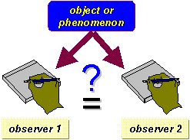
Testing for External Consistency Reliability
2. Intra- Rater Reliability (refer to consistency of a researcher's behavior).
Used to assess the degree to which different raters/observers give consistent estimates of the same phenomenon.
How to measure it
To measure interrater reliability, different researchers conduct the same measurement or observation on the same sample. Then you calculate the correlation between their different sets of results. If all the researchers give similar ratings, the test has high interrater reliability.

Slide 26
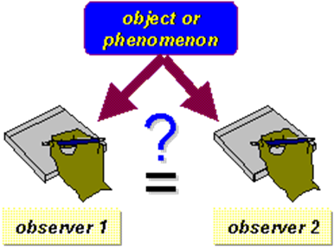
Testing for External Consistency Reliability
EX:A team of researchers observe the progress of wound healing in patients. To record the stages of healing, rating scales are used, with a set of criteria to assess various aspects of wounds. The results of different researchers assessing the same set of patients are compared, and there is a strong correlation between all sets of results, so the test has high interrater reliability.
Improving interrater reliability
Clearly define your variables and the methods that will be used to measure them.
Develop detailed, objective criteria for how the variables will be rated, counted or categorized.
If multiple researchers are involved, ensure that they all have exactly the same information and training.

Slide 27
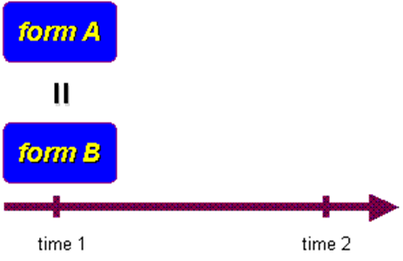
Testing for External Consistency Reliability
3. Parallel-Forms Reliability:
Used to assess the consistency of the results of two tests constructed in the same way from the same content domain.
How to measure it
The most common way to measure parallel form's reliability is to produce a large set of questions to evaluate the same thing, then divide these randomly into two question sets.
The same group of respondent's answers both sets, and you calculate the correlation between the results. High correlation between the two indicates high parallel form's reliability.

Slide 28
Testing for External Consistency Reliability
EX: A set of questions is formulated to measure financial risk aversion in a group of respondents. The questions are randomly divided into two sets, and the respondents are randomly divided into two groups. Both groups take both tests: group A takes test A first, and group B takes test B first. The results of the two tests are compared, and the results are almost identical, indicating high parallel form's reliability.
Improving parallel form's reliability
Ensure that all questions or test items are based on the same theory and formulated to measure the same thing.

Slide 29
Internal Reliability
Internal consistency
Internal consistency assesses the correlation between multiple items in a test that are intended to measure the same construct.
You can calculate internal consistency without repeating the test or involving other researchers, so it’s a good way of assessing reliability when you only have one data set.
How to measure it
Two common methods are used to measure internal consistency.
Average inter-item correlation: For a set of measures designed to assess the same construct, you calculate the correlation between the results of all possible pairs of items and then calculate the average.
Split-half reliability: You randomly split a set of measures into two sets. After testing the entire set on the respondents, you calculate the correlation between the two sets of responses.

Slide 30
Internal Reliability
Internal consistency example
A group of respondents are presented with a set of statements designed to measure optimistic and pessimistic mindsets. They must rate their agreement with each statement on a scale from 1 to 5. If the test is internally consistent, an optimistic respondent should generally give high ratings to optimism indicators and low ratings to pessimism indicators. The correlation is calculated between all the responses to the “optimistic” statements, but the correlation is very weak. This suggests that the test has low internal consistency.
Improving internal consistency
Take care when devising questions or measures: those intended to reflect the same concept should be based on the same theory and carefully formulated.

Slide 31
Testing for Internal Consistency Reliability
This measures the extent to which a test procedure is consistent within itself, i.e., questionnaire items or questions in an interview should all be measuring the same thing.
1. Cronbach's alpha
2. Split-half reliability
3. Average Inter-Item Correlation
4. Item-Total Correlation

Slide 32
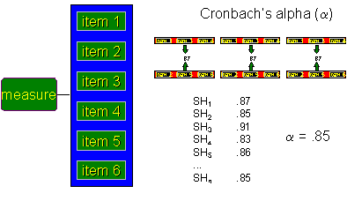
Testing for Internal Consistency Reliability
1. Cronbach’s Alpha:
Measures the overall consistency of items within a test or scale.
A high alpha suggests that items are measuring the same underlying construct.
How to measure it
Cronbach’s Alpha coefficient (values range from 0 to 1, with ≥ 0.7 being acceptable).
EX: A customer satisfaction survey with 10 questions; a high alpha means the questions consistently measure satisfaction.
Improving Cronbach’s Alpha reliability
Remove weak or irrelevant items, ensure items assess the same concept, increase the number of related items.

Slide 33
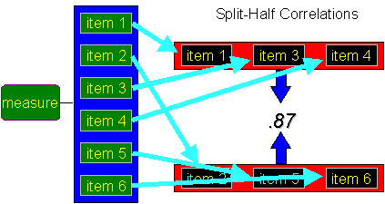
Testing for Internal Consistency Reliability
2. Split-Half Reliability
Assesses internal consistency by dividing a test into two halves and checking if both provide similar results.
How to measure it
Correlation between two halves of the test (Spearman-Brown formula can be used for correction).
EX: A psychology exam split into even and odd questions; if both halves yield similar scores, the test has strong reliability.
Improving Split-Half reliability
Ensure each half has a balanced mix of questions, increase the number of test items, avoid ambiguous questions.

Slide 34
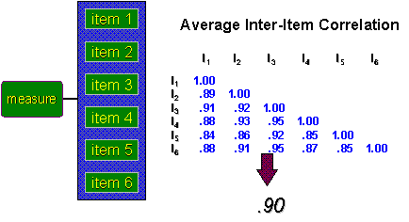
Testing for Internal Consistency Reliability
3. Average Inter-Item Correlation
Evaluates how well individual items on a test correlate with each other, ensuring they measure the same concept.
How to measure it
Calculate the average of all inter-item correlations. Typically, values between 0.15 and 0.50 are acceptable.
EX: In a depression scale, if questions about mood, appetite, and sleep are all correlated, the scale has good inter-item reliability.
Improving Average Inter-Item Correlation reliability
Rewrite or remove poorly correlated items, ensure all questions are conceptually related.

Slide 35
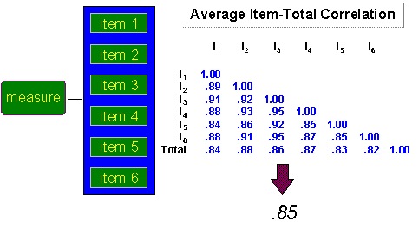
Testing for Internal Consistency Reliability
4. Item-Total Correlation
Measures how well each test item correlates with the total test score, identifying weak items.
How to measure it
Compute correlation between individual items and the total score (values ≥ 0.3 are acceptable).
EX: In a math test, if one question has a low item-total correlation, it may not be assessing the same ability as the rest of the test.
Improving Item-Total Correlation reliability
Remove or revise items with low correlation, ensure all items assess the same concept

Slide 36
Assessment result may be inconsistent:
The behavior being measured is unstable over time because of fluctuations in memory, attention, and effort; or very emotional or health status.
The sample of tasks varies from one assessment to be easier than another because it contains tasks related to topics they know well.
Assessment conditions vary significantly between assessments.
Scoring procedures are inconsistent ( the same rater may use different criteria on different assessments, or different raters may not reach perfect agreement on the same assessment.

Slide 37
How to calculate assessment score
For purpose of under standing sources of inconsistency, it is helpful to view an assessment score as having two components,
X= T+E
(X) Obtained score.
(T) Hypothetical true score.
(E) Amount of measurement error.

Slide 38
Factors That Influence the Reliability of Scores These factors can be categorized into three main sources:
Assessment related factors include the length of the test, the homogeneity of assessment tasks, and the difficulty and discrimination ability of the individual items. | The assessment instrument itself
Student-related factors include the heterogeneity of the student group test-taking ability, and motivation. | The Student/ Sample / Participants:
Inadequate time to complete the assessment can lower the reliability of scores because some students who know the content well will be unable to respond to all of the items | The assessment administration conditions:

Slide 39
Limitation of reliability
Focus Area | Examples of Limitations | Strategies to Overcome Limitations
Understanding Reliability | Lack of consistency in patient assessments across nurses. | Conduct training sessions to standardize assessment protocols.
Methodological Limitations | Variability in data collection methods (e.g., different tools used for the same measurement). | Use validated and standardized tools for data collection.
Sample Size and Composition | Small or non-representative sample sizes in studies. | Increase sample size and ensure diversity in participant selection.
Time Constraints | Limited time for nurses to participate in research activities. | Allocate dedicated time for research and integrate it into routine workflows.
Resource Limitations | Insufficient access to advanced technology or research materials. | Advocate for funding and collaborate with institutions to share resources.
Ethical Considerations | Challenges in maintaining patient confidentiality during studies. | Implement strict data protection measures and obtain informed consent.
Review and Feedback | Lack of peer review or feedback mechanisms for improving reliability. | Establish peer review committees and encourage collaborative discussions among nursing professionals.

Slide 40
Application
Validity
Face validity.
content validity.
Construct validity.
Criterion validity.
Reliability
Test-retest reliability
Internal consistency reliability
Cronbach's alpha
Split-half reliability
Parallel forms reliability.

Slide 41
Glasgow Coma Scale Assessment tool
Glasgow Coma Scale (GCS) was introduced in 1974 as a tool to standardize the assessment of the level of consciousness of patients. GCS was considered to be the gold standard method for this purpose.
The Major use of GCS assessment tool is to assess patients' level of consciousness. It consist of f three components (eye opening, best verbal response, and best motor response). ( Reith et al., 2016)

Slide 42
Glasgow Coma Scale tool

Slide 43
Face Validity

Slide 44
Content Validity
Preparing content validation form :
The ideal number of experts should be not less than (3) experts and (7) expert would be useful to judge the content domains.
Dear field expertise as you look at the GCS tool, please check for content validity as you noticed the degree of relevance as listed:
Degree of relevance
Each item score is (1) means highly relevant to measured domain.
Each item score (0) means not relevant to measured domain.
(Almanasreh, Moles, & Chen, 2019)

Slide 45
Content Validity Form

Slide 46
Example of Content Validity

Slide 47
Construct Validity

Slide 48
Construct Validity

Slide 49
Criterion Validity

Slide 50
Criterion Validity
Bring a standardized tool already valid ( AVPU) then compare this tool to GCS tool and then we look for any correlation between them.
The correlation between them should range between:
A correlation -1 indicates negative correlation.
A correlation coefficient of 1 indicates a positive correlation.
A correlation coefficient of 0 indicates no linear relationship between the variables.

Slide 51
Reliability Application
Test Re-test Reliability:
It is a measure of the consistency or stability of a measurement over time.
Select the sample
Administer test
Time interval
Re administer
Test
Collect the result
Analyze the data
Interpret the results

Slide 52
Internal Consistency Reliability
Cronbach's alpha is a statistic used to measure the internal consistency or reliability of a scale. The normal range of values can be between 0.00 & 1.00 (Polit & Beck, 2012).

Slide 53
Example Cronbach's alpha
Cowan et al. (2008).

Slide 54
Split-half Reliability
This can be done by splitting the items in half (odd versus even items)
Scores are calculated separately for each half of the instrument.
Assessing consistency obtained from the two halves and then compared to assess the consistency between them.
A higher correlation coefficient indicates greater internal consistency and reliability of the instrument.
If the correlation coefficient is 0,80 it indicates a reasonably high level of consistency good internal consistency and reliability of the questionnaire

Slide 55
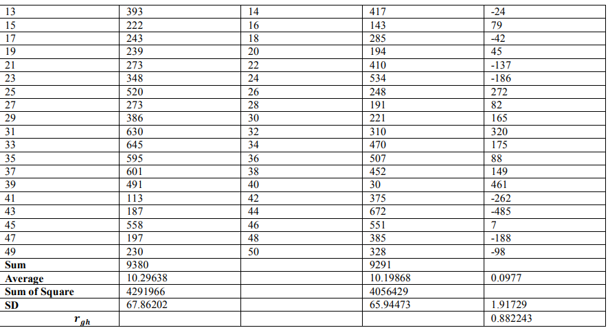
Split-half Reliability

Slide 56
Parallel Forms Reliability
known as alternate forms reliability, is a method of assessing the reliability of a measurement instrument by comparing two or more parallel forms of the instrument.
It involves administering different but equivalent versions of the same test or questionnaire to the same group of participants and examining the consistency of scores between the forms.
(Bolarinwa, 2015).

Slide 57
Steps of Parallel Forms Reliability
1- Create two or more parallel that consist of equivalent forms of the measurement instrument.
2- Randomly assign participants into two groups, and administer one form to each group
3- Obtain responses or scores from the participants for each form of the instrument.
4- Calculate reliability coefficients for each form separately using appropriate reliability coefficient for parallel forms is the Pearson correlation coefficient.
5- Assess the reliability of the instrument by examining the correlation coefficient .

Slide 58
Interrater Reliability
Inter-Rater Reliability: it examines the consistency of a measure when administered by different raters or observers.
It evaluates the level of agreement or consistency in the ratings or scores assigned by multiple individuals. (e.g. Cohen’s Kappa Statistic)

Slide 59
Example of Interrater Reliability

Slide 60
References
Almanasreh, E., Moles, R., & Chen, T. F. (2019). Evaluation of methods used for estimating content validity. Research in social and administrative pharmacy, 15(2), 214-221.
Mary W. Murigi, Ramadimetja S. Mogale, Miriam M. Moagi. (August 18, 2020). Principles and methods of validity and reliability testing of questionnaires used in social and health science researches. Nigerian Postgraduate Medical Journal, 22(4), 195-201.‏
Cowan, D. T., Wilson-Barnett, D. J., Norman, I. J., & Murrells, T. (Feb 23, 2025). Measuring nursing competence: Development of a self-assessment tool for general nurses across Europe. International journal of nursing studies, 45(6), 902-913.‏ https://www.researchgate.net/publication/6376702_Measuring_nursing_competence_Development_of_a_self-assessment_tool_for_general_nurses_across_Europe
Creswell, J. W., & Creswell, J. D. (2017). Research design: Qualitative, quantitative, and mixed methods approaches. Sage publications.
Oermann, M. H., & Gaberson, K. B. (2016). Evaluation and testing in nursing education. Springer Publishing Company.‏
Reith, F. C., Van den Brande, R., Synnot, A., Gruen, R., & Maas, A. I. (Oct 22, 2024 ). The reliability of the Glasgow Coma Scale: a systematic review. Intensive care medicine, 42, 3-15.‏
Trochim, William M.K. " Types of Validity: What Every Researcher Should Know". May 23, 2024

Slide 61
Thank you

